Slide 1

Bachelor of Computer Application (BCA) – III
Semester - V
Compiler Construction
Unit – IV
Dr Liladhar Rewatkar
M. Sc., M. Phil., Ph. D.
Assistant Professor,
Department of Computer Science
Prerna College of Commerce, Reshimbag, Nagpur

Slide 2
Parser
A Syntax analyzer or parser is a program which performs syntax analysis.
A parser takes a string of tokens from the lexical analyzer as an input and check, whether that string is valid construct of the source language or not, if yes it gives or draws a parse tree to indicate that string is correct otherwise it produce an error message.
Role of Parser- The parser obtains a sting of tokens from the lexical analyzer and checks whether that string can be generated by the Context Free Grammar for the source language.

Slide 3
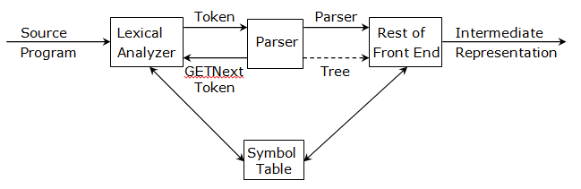
Parser
The process of parsing is shown in following diagram.
A parser for programming language always makes a single left-to-right scene over the input looking ahead one token at a time.
A parser can be constructed for any grammar.

Slide 4
Parser
The parser which are commonly used in compilers are classified as Top-down and Bottom-up parser.
Top-down parser builds parser trees from the top to down i.e. from root to leaves,
While bottom-up parser starts from the leaves and work up the root.
In both case, one thing is important that, the input to the parser is scanned from left to right, only one symbol at a time.

Slide 5
Shift – Reduce Parsing
A bottom-up style of parsing is called as shift-reduce parsing.
This parsing method is bottom-up because it attempts to construct a parse tree for an input string beginning at the leaves i.e. the bottom and working up towards the root i.e. top.
This is the process of “reducing” a string w to the start symbol of the grammar.
At each step a string matching the right side of a production is replaced by the symbol on the left.
E → id

Slide 7
Shift – Reduce Parsing
For example- Consider the grammar
S → aAcBe
A → Ab/b
B → d and the string abbcde
Here we want to reduce the string “abbcde” to start symbol S. We scan abbcde looking for substrings that match right side of some production.
The substring b and d are those substrings that match RHS of the production, so they select the leftmost b and replace it by A, the left side of the production A → b. Here we obtain string aAbcde

Slide 8
Shift – Reduce Parsing
Now we find that Ab, b and d each match the right side of some production.
Now replace Ab by A, the left side of the production A → Ab. Now we obtain aAcBe by start symbol S as follows.
Abbcde → aAbcde since A → b
→ aAcde since A → Ab
→ aAcBe since B → d
→ S since S → aAcBe
In above process, the replacement of right side of a production by the left side is called as Reduction.

Slide 9
Shift – Reduce Parsing
Thus in above example, we reduce the string abbcde to S by sequence of four reductions.
These reductions, traced out the rightmost direction in reverse.
Handle- A substring which is the right side of a production such that replacement of that substring by the production left side leads eventually to reduction to the start symbol, by the reverse of a rightmost derivation is called a handle.

Slide 10
Operator Precedence Parsing
Operator precedence parsing defines three disjoint precedence relations <•, =, •>, between the pairs of terminals.
The meaning of these precedence relations is given below.
Relation | Meaning
a <• b | a “yields precedence to” b
a = b | a “has the same precedence as” b
a •> b | A “takes precedence over” b

Slide 11
Operator Precedence Parsing
These are two ways of determining what precedence relations should hold between a pair of terminals.
The first method is based on associativity and precedence of operator.
For example, if * is to have higher precedence than +, we make + <• * and * •> +.
The second method of selecting operator precedence relation is first to construct an unambiguous grammar for the language, a grammar which reflects the correct associativity and precedence in its parse trees.

Slide 12

Operator Precedence Parsing
Suppose that between $a_{i}$ and $a_{i+1}$ exactly one of the relations <•, =, •> holds.
Here $ makes each end of the string and defines $ <• b and b •> $ for all terminals b.
For example, consider one right sentential form id + id * id and precedence relations are as given below.
Operator Precedence Relation
 | id | + | * | $
id |  | •> | •> | •>
+ | <• | = | <• | •>
* | <• | •> | = | •>
$ | <• | <• | <•

Slide 13
Operator Precedence Parsing
Then the string with the precedence relations inserted is
$ <• id •> + < id •> * <• id •> $
The handle can be found out by following processes.
1. Scan the string from left end until the first leftmost •> is encountered. In above example, this occurs between the first id and +.
2. Then scan backwards over any =$ until a <• is encountered. In above example we scan backwards to $

Slide 14
Operator Precedence Parsing
3. The handle contains everything to the first •> and to the right of the <• encountered in step 2, including any intervening or surrounding non-terminals. This is necessary so that two adjacent non-terminals do not appear in a right sentential form
Then we reduce the id to E and we get the right sentential form E + id * id. After reducing the two remaining id’s to E, we get the right sentential form as E + E * E.
Now the string $ + * $ can be obtained by deleting the non-terminals. Inserting the precedence relation, we get
$ <• + <• * •> $.

Slide 15
Operator Precedence Parsing
Example 1- Consider the following grammar
E → E + E
E → E * E
E → (E)
E → id
For the input string id + id * id
Solution- The stack implementation of shift-reduce parsing takes place as follows.

Slide 16
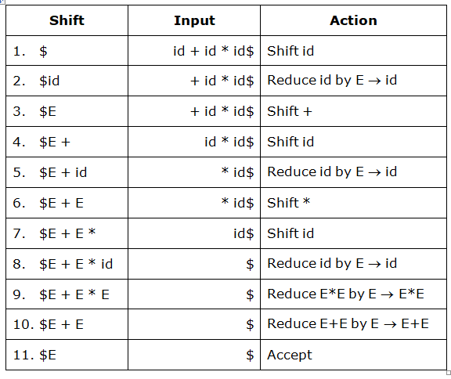
Operator Precedence Parsing

Slide 17
Operator Precedence Parsing
Example 2- Consider the following grammar
S → ABC | AB
A → r | p
B → q | t
C → x
For the input string pqx
Solution- The stack implementation of shift-reduce parsing takes place as follows.

Slide 18
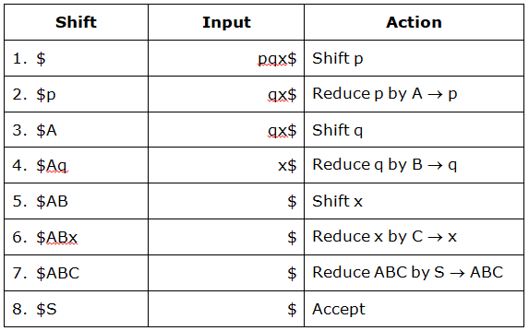
Operator Precedence Parsing

Slide 19
Operator Precedence Parsing
Example 3- Consider the following grammar
S → ABC | gDp
A → DrA | w
B → t
C → S
D → q
For the input string qrwtgqp
Solution- The stack implementation of shift-reduce parsing takes place as follows.

Slide 20
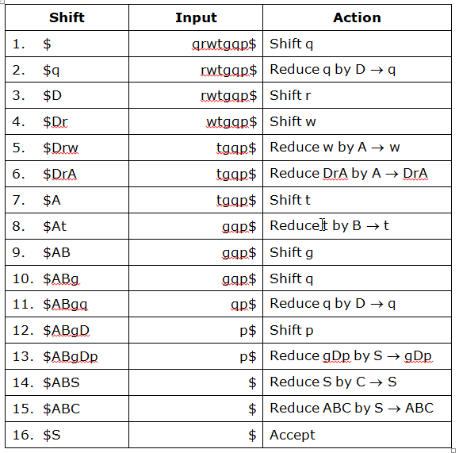
Operator Precedence Parsing

Slide 21
Operator Precedence Parsing
Example 4- Consider the following grammar
S → aBDh
B → Bb | c
D → EF
E → e | ∈
F → e | ∈
For the input string acbbbh.
Give the stack implementation of shift-reduce parsing and show the handles.
Solution- The stack implementation of shift-reduce parsing takes place as follows.

Slide 22
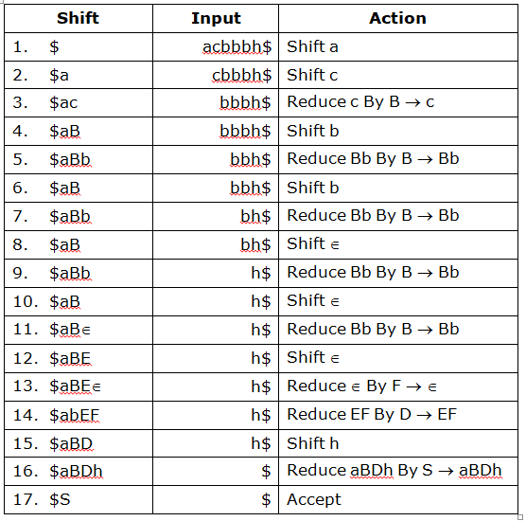
Operator Precedence Parsing

Slide 23
Top Down Parsing
A top-down parser is use to construct a parser tree starting from the root and create the nodes of the parse tree in preorder.
It starts the derivation from the start symbol of the grammar.
It is desirable to construct a derivation that produces terminals in the left to the right fashion in the sentential form as the input tokens are scanned from left to right.
This requirement may be fulfilled by constructing a left-most derivation which has the property that there are only terminal symbol preceding the left most non terminal in any sentential form.

Slide 24
Top Down Parsing
The advantage of top down parser is that parsers can be constructed easily by hand using top down method.
A top down parser start constructing the left most derivation from the start symbol.
For example, consider the grammar
S → cAd
A → aB
B → b / ∈ and the input starting w = cad

Slide 25
Top Down Parsing
To derive this cad from the given grammar we have
S → cAd since S → cAd
→ caBd since S → aB
→ cad since B → ∈
Here the string cad is accepted by the language, as it is derivable from the start symbol of the grammar.

Slide 26
Top Down Parsing
Now to construct the parse tree for above string using top down parsing method, we create a tree constructing of a single node labeled S.
Here the input pointer points to C i.e. the first symbol of w.
We use the first production for S to expand the tree we get,
S
c A d
a B
∈

Slide 27
Predictive Parser
A predictive parser is a program consists of a procedure for every non-terminal.
The unambiguous determines the procedure selected for each non-terminal.
The predictive parser consists of an input, a stack, a parsing table and an output as shown in following figure.
Here the input contain the string to be parsed, followed by $, i.e. the right end marker.
The stack contain a sequence of grammar symbol, preceded by $, the bottom of stack.

Slide 28
Predictive Parser
Initially, the stack contain the start symbol of the grammar preceded by $, the parsing table is a two dimensional array M[A, a], where A is a non-terminal, and a is a terminal or symbol $.
The parser is controlled by a program which determine X, the stack top symbol and a, the current input symbol.
These two symbols determine the action of the parser.

Slide 29
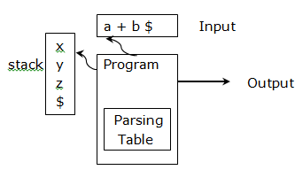
Predictive Parser
Model of Predictive Parser
If M [x, a] = {xuvw}, the parser replace x on the top of the stack by wvu i.e. with u on the top.
Initially when predictive parser starts its working, the parser is in configuration

Slide 30
Predictive Parser
STACK INPUT
$S $W
Where S is the start symbol of the grammar and w is the string to be parsed.
Example- Consider the following grammar
E → TE’
E’ → +TE’
T → FT’
T → FT’ | ∈
F → (E) | id
And the input string id + id * id, the sequence of moves in the predictive parser takes place as follows

Slide 31
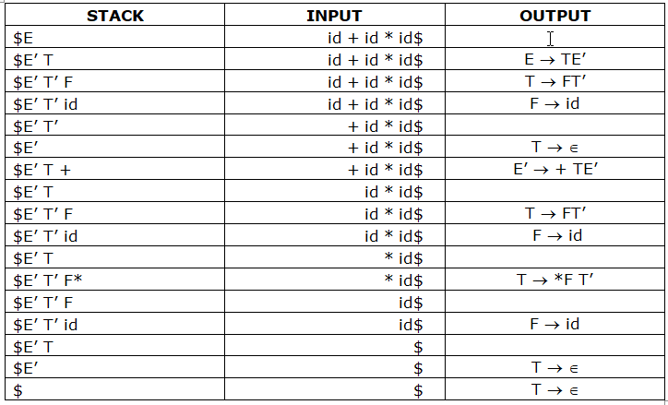
Predictive Parser

Slide 32
Basic Blocks
A basic block is a fundamental unit of code. It is a series of continuous statements in which flow of control enters at the beginning and leave at the end without halt or possibility of branching expect at the end of the basic block.
A small representation of basic blocks is shown below which consists of series of three address statements.
t1 = a * a;
t2 = a * b;
t3 = 2 * t2;
t4 = t1 + t3;
t5 = b * b;
t6 = t4 + t5;

Slide 33
Symbol Table
A compiler needs to collect information about all the data objects that in the source program.
For example, a compiler needs to know whether a variable represents an integer or a real number. What size an array has?, How many arguments a function accepts?.
The information about data objects is collected by the early phases of the compiler, lexical and syntactic analysis and entered into the symbol table.

Slide 34
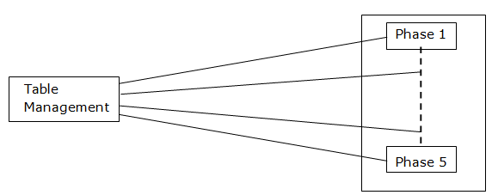
Symbol Table
The information collected about the data objects has a number of uses.
For example, if we have the expression A + B, where A is of type integer and B of type real, and if the language permits an integer to be added to real, then on most computer code must be generated to convert A from type integer to type real before the addition can take place.

Slide 35
Symbol Table
The addition done in floating point and the result is real.
If mix mode expressions of this nature are forbidden by the language, then the compiler must issue an error message when it attempts to generate code for this construct.

Slide 36
Code Optimization
Code optimization is a technique which is used by most of the modern compilers to produce more efficient and simple object code for the source program.
These optimization techniques do not guarantee the full optimization of the target code, so we can call these techniques as code improvement and the compilers that apply code improvement and the compilers that apply code improving techniques are called as optimizing compilers.

Slide 37
Code Optimization
Code optimization phase improve the intermediate code i.e. it reduces the code by removing the repeated and unwanted instructions from the intermediate code.
The quality of a program is measured by its size and its running time.
For large computations, running time is important and for a small computer, size may be important.

Slide 38
The Principle Source Optimization
In optimization process, many transformations can be performed at both local and global levels.
The transformation of a program is called as local if it can be performed by looking only at the statements in a basic block.
Compiler can improve a program without changing its function in several ways. Some of them are as follows.
1. Common Sub Expression Elimination
2. Copy Propagation
3. Dead Code Elimination
4. Constant Folding

Slide 39
The Principle Source Optimization
Common Sub Expression Elimination-
An expression E is called as a common sub expression if E is previously executed and the values of variables in E have not changed since the previous computation.
In other words, if an expression appears more than one time it is said to be repeated and is called as the common expression.
For example, consider the basic block B5 as shown in following

Slide 40
The Principle Source Optimization
B5
t6 = 4 * i;
x = a[t6];
t7 = 4 * i;
t8 = 4 * j;
t9 = a[t8];
a[t7] = t9;
t10 = 4 * j;
a[t11] = x;
goto B2
Basic block before eliminating common sub expression

Slide 41
The Principle Source Optimization
In above basic block, the expressions 4 * i and 4 * j are repeated as t6 = t7 and t8 = t10.
Thus t7 and t10 have the common sub expression 4 * i and 4 * j respectively on the right side.
They can be eliminated by using t6 and t8 using t7 and t10 respectively.
So the above block, after elimination of common sub expression is shown below.

Slide 42
The Principle Source Optimization
B5
t6 = 4 * i;
x = a[t6];
t8 = 4 * j;
t9 = a[t8];
a[t6] = t9;
a[t8] = x;
goto B2
Basic block after eliminating common sub expression

Slide 43
The Principle Source Optimization
Copy Propagation-
The assignment statement of the form a := b is called as copy statement.
In above statement, a and b have the same value, and so anywhere a occurs we can replace it by b.
Here, we will replace all occurrences of a with b so that a becomes dead and its copy statement can be removed.
For example, consider the following basic after eliminating the common sub expression

Slide 44
The Principle Source Optimization
t1 = 4 – 2;
t2 = t1 / 2;
t3 = a * t2;
t4 = t3 * t1;
t5 = t4 + b;
t6 = t4;
t7 = t6 + b;
c = t5 + t7;

Slide 45
The Principle Source Optimization
So the above basic block after copy propagation is shown as
t1 = 4 – 2;
t2 = t1 / 2;
t3 = a * t2;
t4 = t3 * t1;
t5 = t4 + b;
t6 = t4;
t7 = t4 + b;
c = t5 + t7;

Slide 46
The Principle Source Optimization
Here, there is a new common sub expression to be eliminated i.e. t4 + b, then we get the block as
t1 = 4 – 2;
t2 = t1 / 2;
t3 = a * t2;
t4 = t3 * t1;
t5 = t4 + b;
t6 = t4;
t7 = t5;
c = t5 + t7;
We can again perform the copy propagation for further sub expression elimination.

Slide 47
The Principle Source Optimization
Dead Code Elimination-
A variable is said to be live at a point in a program if its value can be used subsequently. Otherwise, it is said to be dead.
A dead code means statements that compute values that never get used.
Generally, the programmer introduces any dead code in the program but it may appear as a result of previous transformation such as copy propagation.
For example, in previous example, after applying copy propagation we get as follows,

Slide 48
The Principle Source Optimization
t1 = 4 – 2;
t2 = t1 / 2;
t3 = a * t2;
t4 = t3 * t1;
t5 = t4 + b;
t6 = t4;
t7 = t5;
c = t5 + t7;
In this code, the sixth instruction defines t6 and this t6 has no further reference in the code. Hence this instruction may be removed from the code. The same thing is true for t7.

Slide 49
The Principle Source Optimization
Thus t6 and t7 both acts as dead code. So after eliminating dead code we get the code as follows.
t1 = 4 – 2;
t2 = t1 / 2;
t3 = a * t2;
t4 = t3 * t1;
t5 = t4 + b;
c = t5 + t7;

Slide 50
The Principle Source Optimization
Constant Folding and Constant Propagation-
Constant folding and constant propagation are related optimization techniques used by many modern compilers.
Constant folding is the process of simplifying constant expression at compiler-time and just uses the constants in the code.
Consider the example after common sub expression elimination.

Slide 51
The Principle Source Optimization
Consider the example after common sub expression elimination
t1 = 4 – 2;
t2 = t1 / 2;
t3 = a * t2;
t4 = t3 * t1;
t5 = t4 + b;
c = t5 + t7;

Slide 52
The Principle Source Optimization
Now by applying constant folding, we can compute t1 = 4 – 2 at compile time to get
t1 = 2;
t2 = t1 / 2;
t3 = a * t2;
t4 = t3 * t1;
t5 = t4 + b;
c = t5 + t7;

Slide 53
The Principle Source Optimization
Now apply constant propagation and dead code elimination, we get
t2 = 2 / 2;
t3 = a * t2;
t4 = t3 * 2;
t5 = t4 + b;
c = t5 + t7;

Slide 54
The Principle Source Optimization
Again we can do the constant folding to give the code as
t2 = 1;
t3 = a * t2;
t4 = t3 * 2;
t5 = t4 + b;
c = t5 + t7;

Slide 55
The Principle Source Optimization
Again after applying the constant propagation and dead code elimination we get
t3 = a * 1;
t4 = t3 * 2;
t5 = t4 + b;
c = t5 + t7;

Slide 56
Loop Optimization
Optimization has to be done within loops especially within inner loops.
The running time of a program may be improved if we decrease the number of instructions in an inner loop, even if we increase the amount of code outside the loop.
Some of loop optimizations techniques are discussed here as follows.
1. Code motion
2. Induction variable elimination
3. Reduction in strength

Slide 57
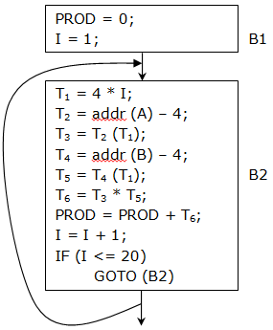
Loop Optimization
Code Motion / Frequency Reduction- Code motion is an important transformation that decreases the amount of code in a loop. This transformation takes an expression that yields the same result independent of the number of times a loop is executed and places the expression before the loop. For example, consider following graphs

Slide 58
Loop Optimization
In above figure, the assignment statement T2 = addr (A) – 4; and T4 = addr (B) – 4; produce the same results which is independent of the number of times a loop is executed.
So these statements act as loop invariant computations.
Here we remove the computations T2 and T4 from block B2 and place them before the loop to execute separate block B3 for statements T2 and T4 which is shown as follows.

Slide 59
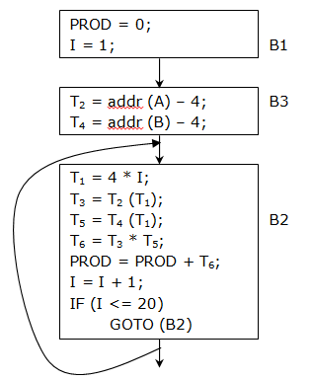
Loop Optimization

Slide 60
Loop Optimization
Induction Variable Elimination-
One of the important loop optimization is induction variable elimination which actually decreases the total number of instructions as well as speeding up the loop.
A induction variable is a variable that gets increased or decreased by a fixed amount of every iteration of a loop.
In the above flow graph, the purpose of variable I is to count from 1 to 20 in the loop and the purpose of T1 is to increment through the array 4 bytes at a time.
The values of I, T1 remain in lock step i.e. for the assignment T1 = 4 * I, variable I has values 1, 2, 3, ….., 20.

Slide 61
Loop Optimization
In each subsequent loop iteration T1 takes the values 4, 8, …., 80. So we can say that both I and T1 form arithmetic progressions. Here these identifiers I and T1 are called as induction variables. So optimized code after eliminating the induction variables I and T1 is shown below.

Slide 62
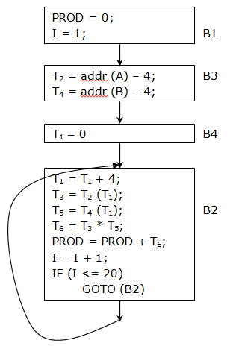
Loop Optimization

Slide 63
Loop Optimization
Reduction in Strength-
Reduction in strength is the process of replacing the complex operations by simple operations to speed up the processing of the object code.
For example, consider the above figure for flow graph after code motion. In this code in block, the multiplication statement is given as T1 = 4 * I.
In above figure, T1 = 4 * I was replaced by a T1 = T1 + 4. This replacement of multiplication statement by addition statement will speed up the object codes if addition takes less time than multiplication. Such a replacement of an operator by a cheaper one is known as Reduction in Strength.

Slide 64
The DAG Representation of Basic Block
Directed Acyclic Graph (DAG) is useful data structures for automatically implementing transformations on each of the basic block.
A DAG is a directed graph with no cycles which gives a picture of how the value computed by each statement in a basic block is used in subsequent statements in the block.
Constructing a DAG from three-address statements is a good way of determining common sub expressions within a block, determining which means are used inside the block but evaluated outside the block and determining which statements of the block could have their value used outside the block.

Slide 65
The DAG Representation of Basic Block
A DAG for basic block is a Directed Acyclic Graph with following labels on nodes.
1. Leaves are labeled by unique identifiers, either variable names or constants. The leaves represent initial values of names and we subscript them with 0.
2. Interior nodes are labeled by operator symbol.
3. Nodes are also optimally given an extra set of identifiers for labels. The identifier is that the interior nodes represent computed values.

Slide 66
DAG Construction
To construct a DAG for a basic block, processing of each statement should be done.
Suppose there is a statement A = B * C.
Scan for the nodes that represent the current value of C. If they are already evaluated by previous statements of the blocks, then they could be interior nodes or they will be leaves.
We create a node *, whose left child will B and right side will C. Then the node * will be represented by node A.
If a node already exists which represents same value B * C, the nodes are not added to the DAG. *
B C

Slide 67
DAG Construction
Algorithm- Constructing a DAG
Input- A basic block
Output- A DAG for the basic block containing the following information.
1. A label for each node. An operator for the interior nodes and identifiers for the leaves.
2. For each node a list of attached identifiers (constants not permitted here)
Method- The DAG construction process is to do the following steps (1) to (3) for each statement of the block

Slide 68
DAG Construction
Suppose the current three address statement is a A = B op C; we do the following steps
1. If NODE(B) is undefined, create a leaf labeled B and let NODE(B) be this node. In case if NODE(C) is undefined, create a leaf labeled C and let NODE(C) be that node.
2. Determine whether there is any node labeled ‘op’ whose left child is NODE(B) and whose right child is NODE(C). If the node ‘op’ is not present, then a new node is created whose leaf nodes are NODE(B) and NODE(C)
3. Set the NODE(A) to the NODE(op) and delete A from the attached identifiers.

Slide 69
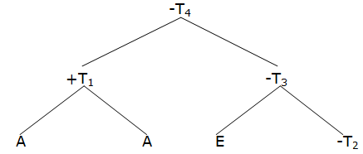
DAG Construction
Example 1- Consider the following three address code for basic block
T1 = A + B; T2 = C + D;
T3 = E – T2; T4 = T1 – T3;
Solution- The DAG representation for above three address code (basic block) is a follows

Slide 70
DAG Construction
Home work-
1) Construct the DAG for the following basic blocks
D = B – C; E = A + B;
B = B – C; A = E – D;
2) Construct the DAG for the statement a + b * (a + b) + c + d
T1 = a + b; T2 = b * T1;
T3 = a + T2; T4 = T3 + c;
T5 = T4 + d;

Slide 71
Application of DAG
We can automatically detect the common sub-expression
We can determine which identifiers have their values used in the block they are exactly those for which a leaf is created.
We can determine which statements compute values that could be used outside the block.

Slide 72
Code Generation
It is the last phase of compilation.
It is machine dependent phase so it is impossible to generate a good code without knowing the details of the particular machine for which compiler generates the code.
The function of code generation is to take the intermediate code of a source program as input and producing the equivalent target i.e. object program.
The output can be either assembly code or machine code.

Slide 73
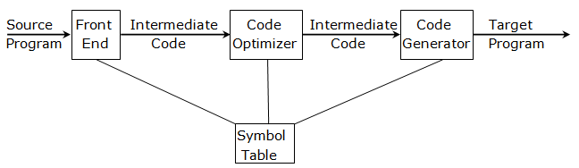
Code Generation
The code generator translates the intermediate code of the source program into sequence of machine instructions.
As shown in above figure, the code optimizer may or may not occur before the code generator.
If code optimization phase occurs before the code generator, then efficient target code can be produced.

Slide 74
Code Generation
The primary goal of code generator is to produce efficient target code.
Code efficiency can be achieved by making use of resources of the target machine.
The code generator must use instruction sets of target machine to produce the efficient machine instructions.

Slide 75
A Machine Model
As code generation is a machine dependent phase, it requires the well knowledge of target machine.
To discuss various issues involved in code generation, we need to describe some of the features of a typical computer and for this purpose a hypothetical machine model is used.
We assume that the machine is byte-addressable with two bytes per word, having two 16 bytes of memory.
We have eight general purpose registers R0 to R7 capable of holding 16 bit quantity.
Format of binary operator instruction is
OP Source Destination

Slide 76
A Machine Model
Here OP is a 4-bit opcode and source and destination is each 6-bit field. Since 6-bit fields is not capable of holding memory address (a memory address is a 16-bit), when source and destination are memory addresses then these 6-bit fields holds certain bit patterns which specify that the words following an instruction contain memory addresses used as source and destination operands respectively.
The following addressing modes are assumed to be supported by the machine modes and they are given with their assembly language mnemonic forms.

Slide 77
A Machine Model
r(register addressing)- Register r contains the operand
*r(indirect register)- Register r contains the address of the operand
X(absolute address)- The address of X follows the instruction
#X(immediate)- The word following the instruction contains the literal operand X.
X(r) (Indexed Address) value X which is found in the word following the instruction, in added to the contents of register r to produce the address of the word containing the address of the operand.

Slide 78
A Machine Model
6. *X(r) (Indirect Indexed address)- value X which, stored in the word following the instruction, is added to the contents of register to produce the address of the operand.
We assume that the opcodes listed below are available.
a) MOV (for moving source to destination)
b) ADD (for adding source to destination)
c) SUB (for subtracting source from destination)

Slide 79
A Machine Model
The cost of the instruction is considered to be its length because generating a shorter instruction not only reduces the storage requirement of the object code but it also bring down the time taken to perform the operation, because on most of the machines, the time taken to fetch a word from the memory exceeds the time spent in executing the instruction and hence by minimizing the instruction length we can approximately minimize the time taken to perform on instruction.

Slide 80
A Simple Code Generator
A simple code generator generates target code for sequence of three address statement.
For each operator in a statement there is a corresponding target language operator.
We also assume that computed results can be left in registers as long as possible, storing them only
1. If their register is needed for another computation
2. Just before a procedure call, jump or labeled statement, i.e. everything must be stored just before the end of a basic block.

Slide 81
A Simple Code Generator
Next Uses- The use of a name in a three address is defined as “suppose three address statement ‘i’ assigns a value to x. If statement ‘j’ has x as an operand, and control can flow from statement ‘i’ to ‘j’ along a path that has no intervening assignment to x, then we say statement ‘j’ uses the value of x computed as ‘i’.
Register and Address Descriptors- After computing next-use information, forward pass through the block should be performed. To perform register allocation, the code generation algorithm will make use of descriptors to keep track of register contacts and addresses for names. There are two types of descriptors.

Slide 82
A Simple Code Generator
Register Descriptor- It keep track of contents of each register at any instant of time. Initially, the descriptors show that all the registers are empty. As the code generation progresses, each register will hold the values of zero or more names. The register descriptor will be consulted whenever there is a need of a new register.
Address Descriptor- An address descriptor keeps track of the location where the current value of the name can be found at run-time. The location may be a register a stack location or any memory address. This information can be stored in the symbol table and is used to determine the accessing methods for a name.

Slide 83
A Simple Code Generator
A code-Generation Algorithm- The code-generation algorithm takes as input a sequence of three-address statements constituting a basic block. For each three-address statement of the form x := y op z, we perform the following actions:
Invoke a function getreg to determine the location L where the result of the computation y op z should be stored. L will usually be a register, but it could also be a memory location.
Consult the address descriptor for y to determine y’, which is one of the current location of y. prefer the register for y’ if the value of y is currently both in memory and a register. If the value of y is not already in L. Generate the instruction MOV y’, L to place a copy of y in L.

Slide 84
A Simple Code Generator
3. Generate the instruction OP z’, L, where z’ is a current location of z. again, prefer a register to a memory location if z is in both. Update the address descriptor of x to indicate that x is in location L. If L is a register, update its descriptor to indicate that it contains the value of x, and remove x from all other register descriptors.
4. If the current values of y and/or z have no next use, are not live on exit from the block, and are in registers, alter the register descriptor to indicate that, after execution of x := y OP z, those registers no longer will contain y and/or z respectively.

Slide 85
A Simple Code Generator
Example- The assignment d := (a – b) + (a – c) + (a – c) might be translated into the following three-address code sequence
t := a – b
u := a – c
v := t + u
d := v + u
with d live at the end. The code generation algorithm given above would produce the code sequence shown in following figure.

Slide 86
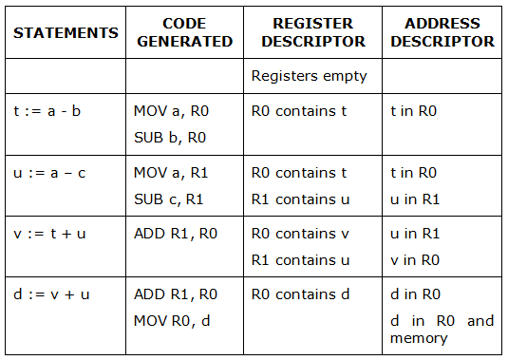
A Simple Code Generator
Figure shows the values of register and address descriptor as code generation progresses. Figure does not shown a, b and c in address descriptor because they are memory. We also assume that t, u and v being temporaries are not in memory

Slide 87
Register Allocation and Assignment
Instructions involving only register operands arc shorter and faster than those involving memory operands.
Therefore, efficient utilization of registers is important in generating good code.
This section presents various strategies for deciding what values in a program should reside in registers (register allocation) and in which register each value should reside (register assignment).
One approach to register allocation and assignment is to assign specific values in an object program to certain registers.

Slide 88
Register Allocation and Assignment
For example, a decision can be made to assign base addresses to one group of registers, arithmetic computation to another, the top of the run-time stack to a fixed register, and so on.
This approach has the advantage that it simplifies the design of a compiler.
Its disadvantage is that, applied too strictly. it uses registers inefficiently; certain registers may go unused over substantial portions of code, while unnecessary loads and stores are generated.

Slide 89
Register Allocation and Assignment
Nevertheless, it is reasonable in most computing environments to reserve a few registers for base registers, slack pointers and the like, and to allow the remaining registers to be used by the compiler as it sees fit.
Global Register Allocation-
The code-generation algorithm in above used registers to hold values for the duration of a single basic block.
However, all live variables were stored at the end of each block.

Slide 90
Register Allocation and Assignment
To save some of these stores and corresponding loads, we might arrange to assign registers to frequently used variables and keep these registers consistent across block boundaries (globally).
Since programs spend most of their time in inner loops, a natural approach to global register assignment is to try to keep a frequently used value in a fixed register throughout a loop.
For the time being, assume that we know the loop structure of a flow graph, and that we know what values computed in a basic block are used outside that blocks.

Slide 91
Register Allocation and Assignment
One strategy for global register allocation is to assign some fixed number of registers to hold the most active values in each inner loop.
The selected values may be different in different loops. Registers not already allocated may be used to hold values local to one block.

